Slide 1
Tales from Developer Tester Collaboration
Maaret Pyhäjärvi & Llewellyn Falco

Slide 2
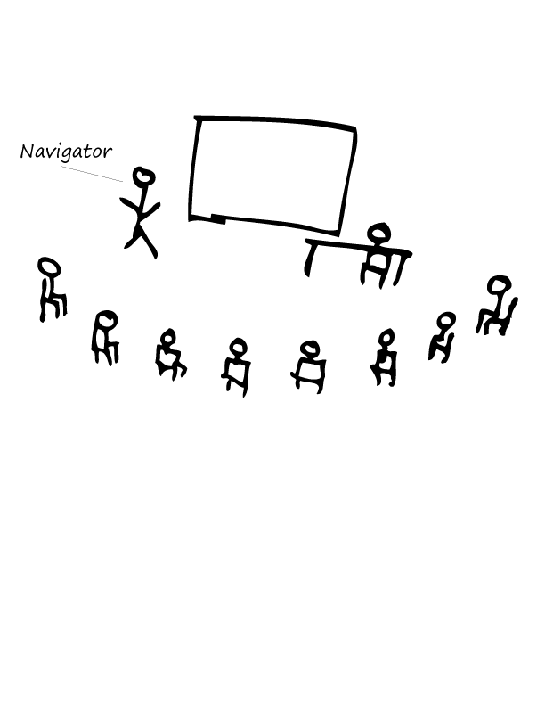
A day of mobbing

Slide 3
That would’ve been a nasty one to find later
* http://visible-quality.blogspot.fi/2015/09/my-first-full-day-of-mob-programming.html

Slide 4
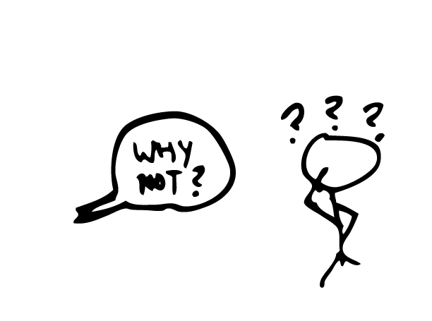
Pair Writing
?!?%#

Slide 5

1st session on unit testing
* http://visible-quality.blogspot.fi/2015/01/a-learning-journey-with-unit-tests-just.html

Slide 6
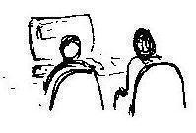
Strong Style Pairing
“For an idea to go from your head to the computer it must go though someone else’s hands”
*http://llewellynfalco.blogspot.fi/2014/06/llewellyns-strong-style-pairing.html

Slide 7


Farming vs. Hunting

Slide 8
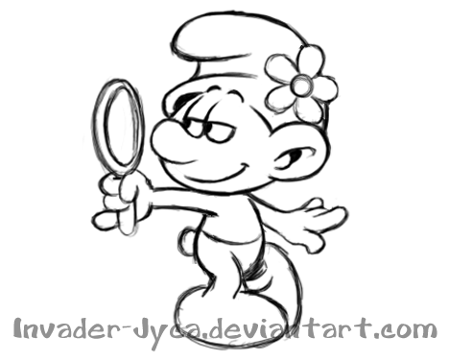
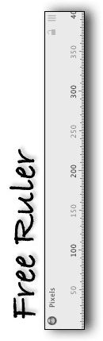
“Look at me” Pairing

Slide 9
Why are we having issues?

Slide 10
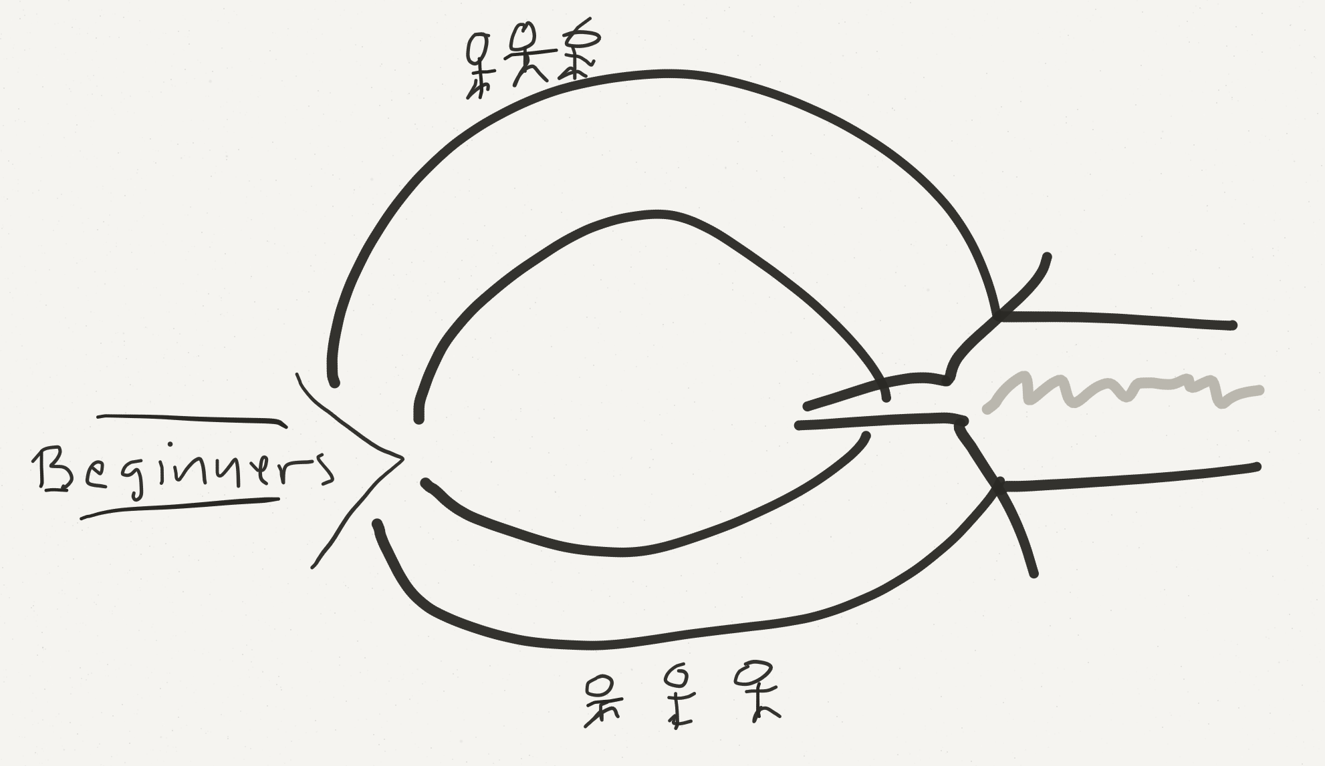
How we became how we are

Slide 11
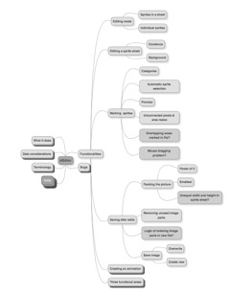
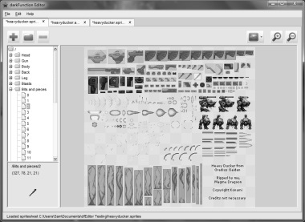
Exploratory Testing

Slide 12
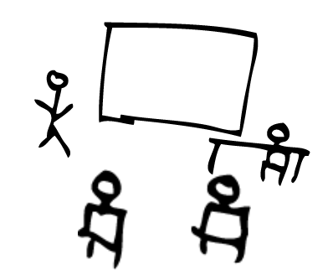

Testing Excel

Slide 13
Why do this?
“It’s about getting the best (not the most)
out of everyone”

Slide 14
Quality

Slide 15
Quality

Slide 16
Pairing & Mobbing
Some dev care about testing
Skilled tester exist
MindMaps are amazing
Remote desktop
Quality
Some testers are great product owners
Testers don’t report everything
More powerful unit tests

Slide 17
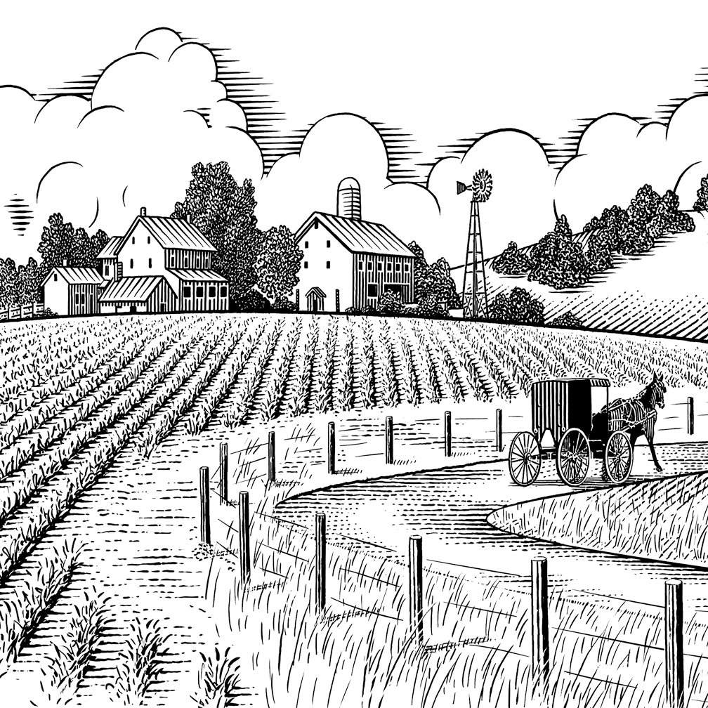
Thank you.
@maaretp
@LlewellynFalco
(please connect with us through Twitter or LinkedIn)

